Slide 1
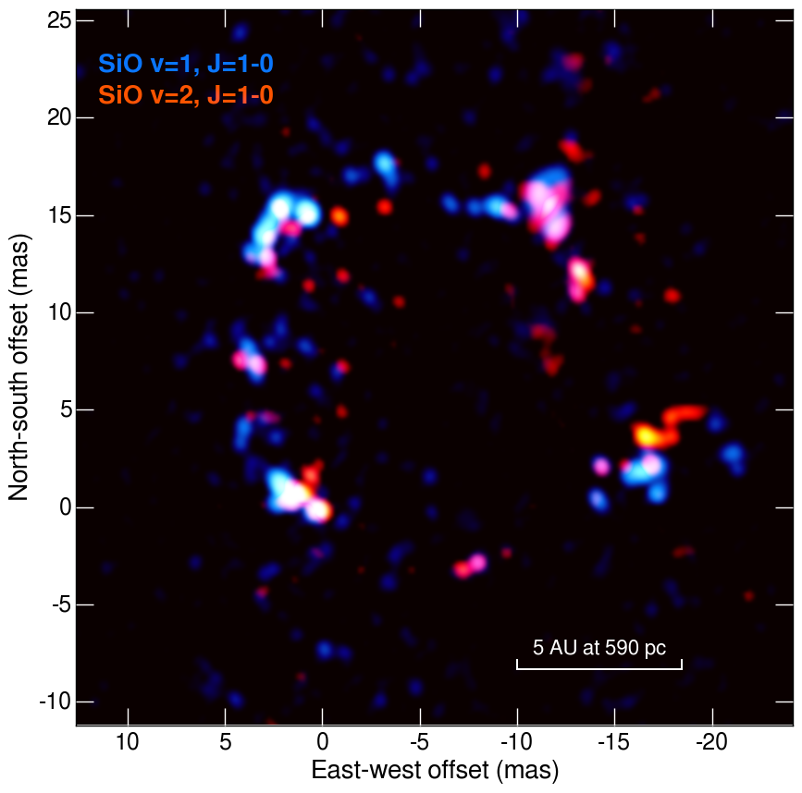
Study on circumstellar maser sources and the JVN (towards the SKA)
Hiroshi Imai
Research and Education Assembly
Science and Engineering Area,
International Radio Astronomy
Collaboration Promotion Office
Kagoshima University
SiO masers around
WX Psc
(Yun et al. 2016)

Slide 2
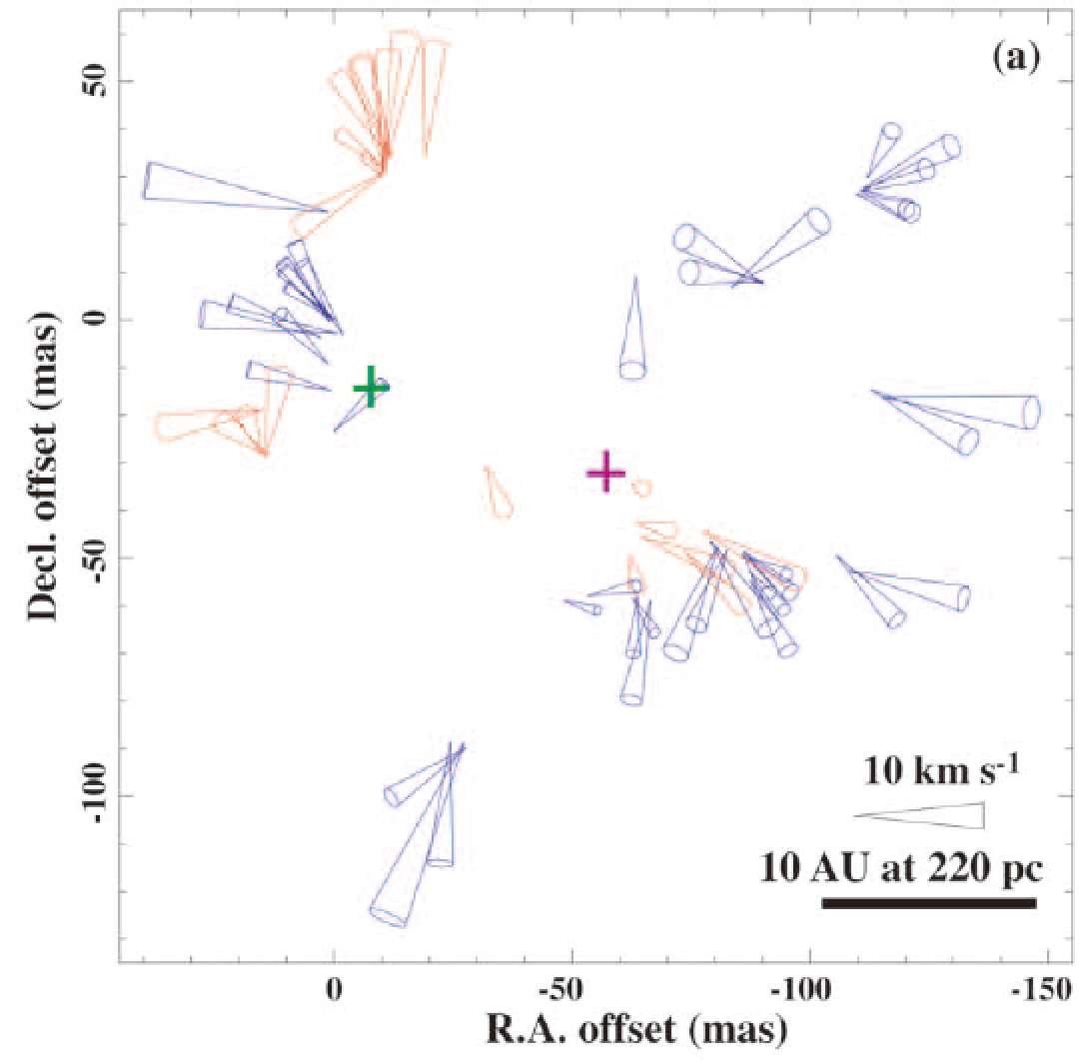
JVN image of H₂O masers around RT Virginis (u16150b, preliminary)
0.29 Jy/beam
T_{int}= 2 hr
c.f. VLBA observations in 1998
(Imai et al. 2003)

Slide 3
I do not suggest intensive study on circumstellar masers with JVN.
Instead, I do suggest some strategies in stellar maser study with JVN.
Movie of SiO masers around TX Cam
(Diamond & Kemball 2003; Gonidakis et al. 2010; Gonidakis et al. 2013)
KaVA Large Projects
on circumstellar masers
(2017—2025?)

Slide 4
How is JVN characterized?
flexible ≠ systematic
Unstable (errors, bad weather)
→ compensated by flexibility
High sensitivity
(c.f. EVN, HSA=High Sensitivity Array)
High dynamic range
(in full operation)

Slide 5
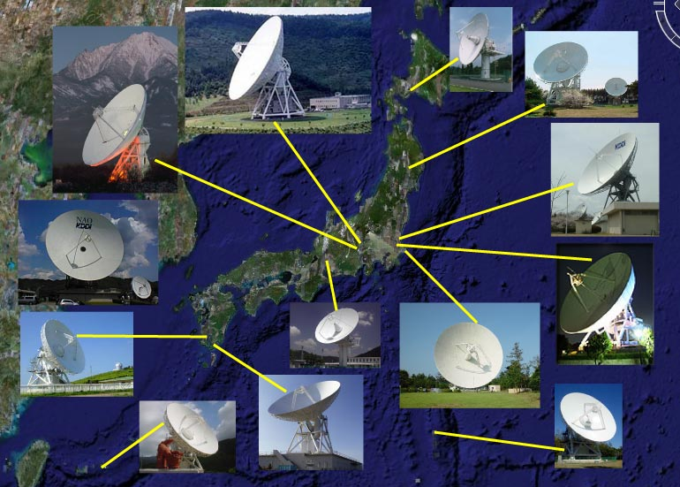
The Ibaraki Array (first but last operation of …?)
Baselines as short as 50 km (c.f. MERLIN)

Slide 6
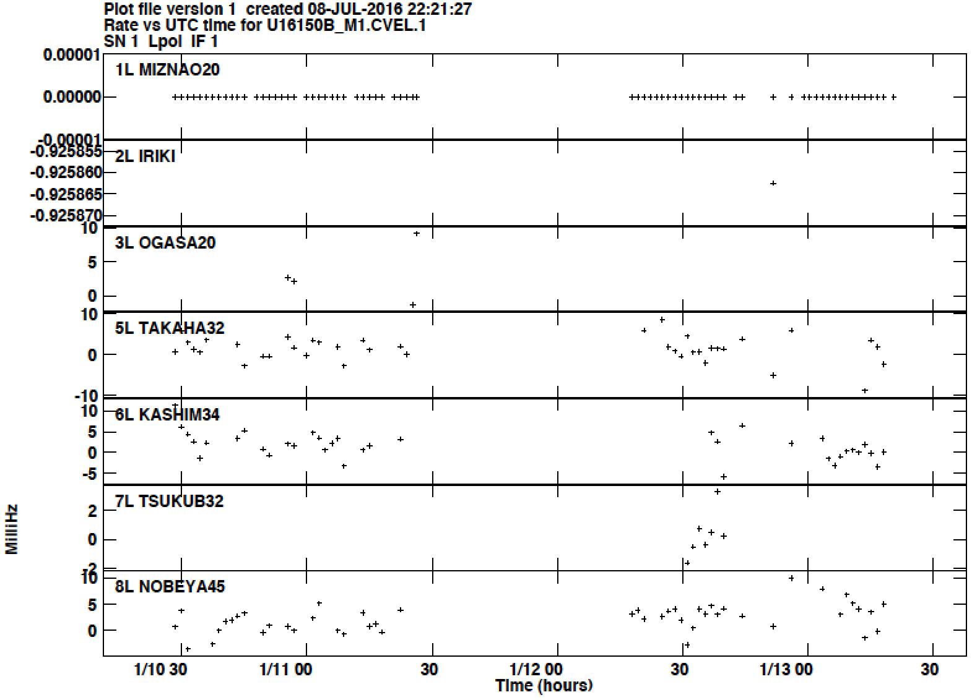
Extended circumstellar H₂O masers with JVN
Fringe fitting (rate) solutions for W Hya @100 pc in u16150b

Slide 7
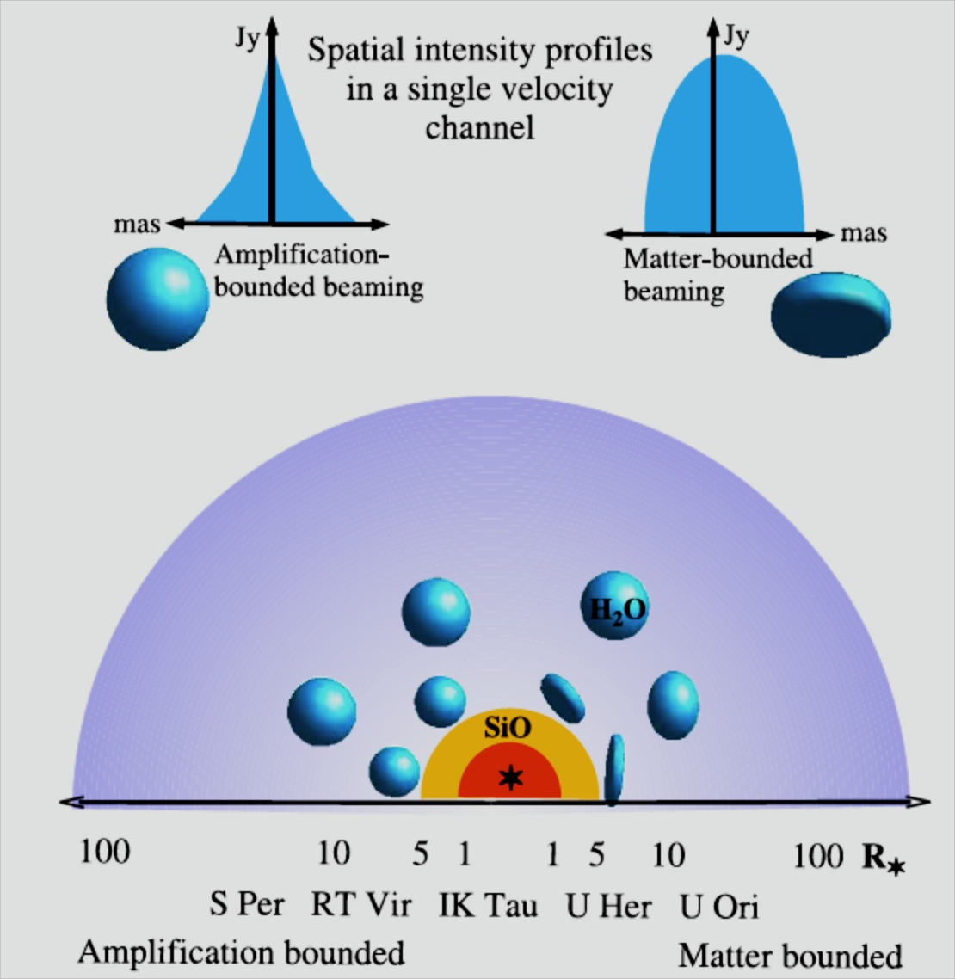
Microscopic view for exploring macroscopic structure of CSEs
Beaming angle
~apparent spot size/ spot distribution in maser features
⇩
Important clues to CSE structure
Shock wave propagation
or
physical condition variation by star light
Richards (2010)

Slide 8
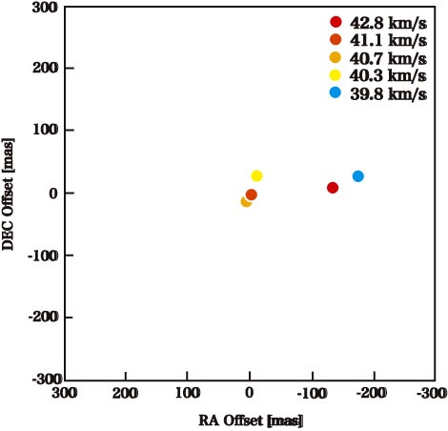
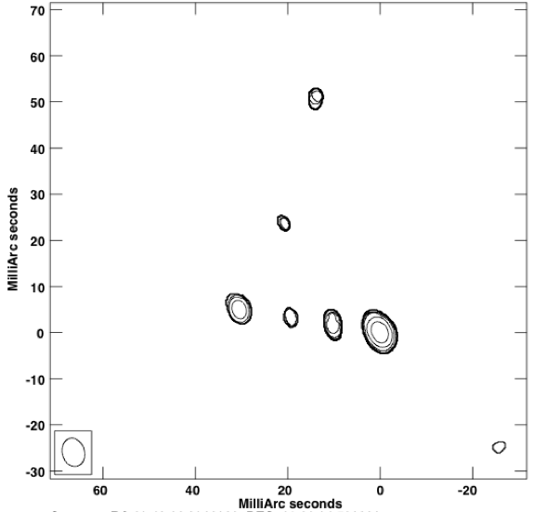
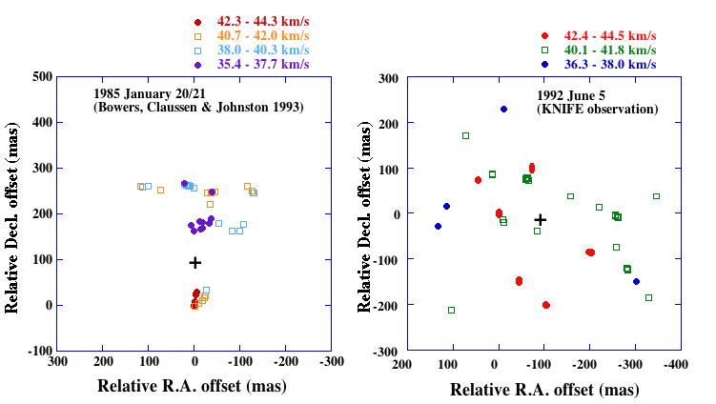
Periodic behavior of H₂O maser distributions?
H₂O masers in W Hya
(Imai et al. 2016 in prep.)
How to get visible and invisible?
Compact spot visible in a specific pulsation phase?
Decadal evolution with mass loss history?
(comparison with previous
maps if available)
2005 January 20
2013 January 8
VERA (1000 km) KaVA (400 km)
Loose monitoring
of red supergiants
(Asaki et al.)
VLA (baseline 30 km) KNIFE (200 km)

Slide 9
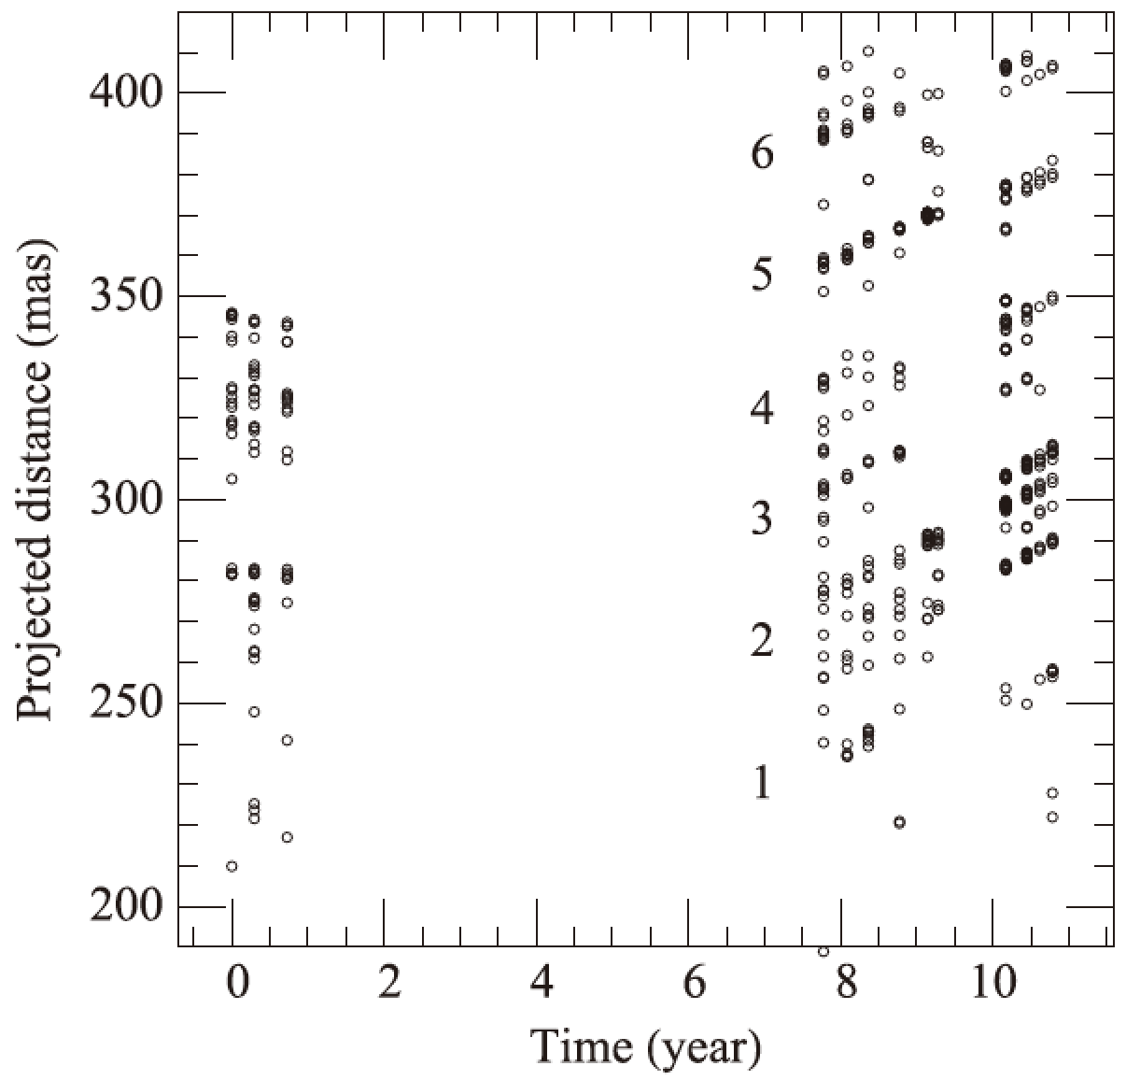
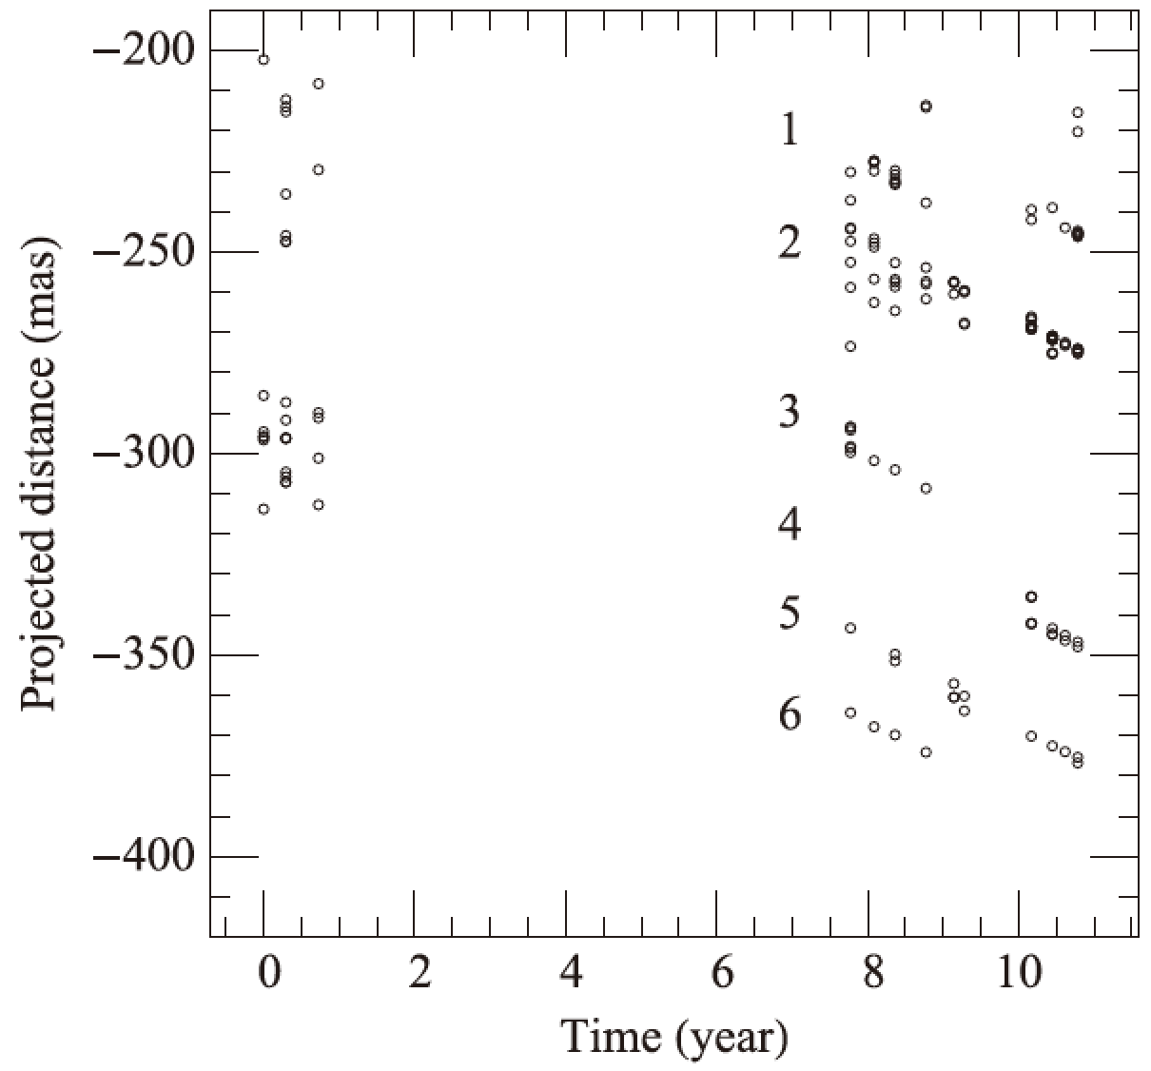
Decadal evolution of a water fountain source
W43A
Imai et al. (2002, 2007)
Chong, Imai & Diamond (2015)
Dynamical age: ~50 yr (born around 1965)

Slide 10
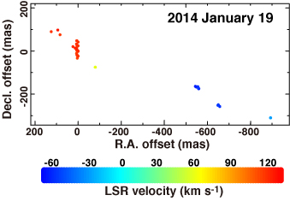
Decadal evolution of a water fountain source
W43A
Imai et al. (2002, 2007)
Chong, Imai & Diamond (2015)
Dynamical time scale
~ Dynamical age
(Imai et al. 2016 in prep.)

Slide 11
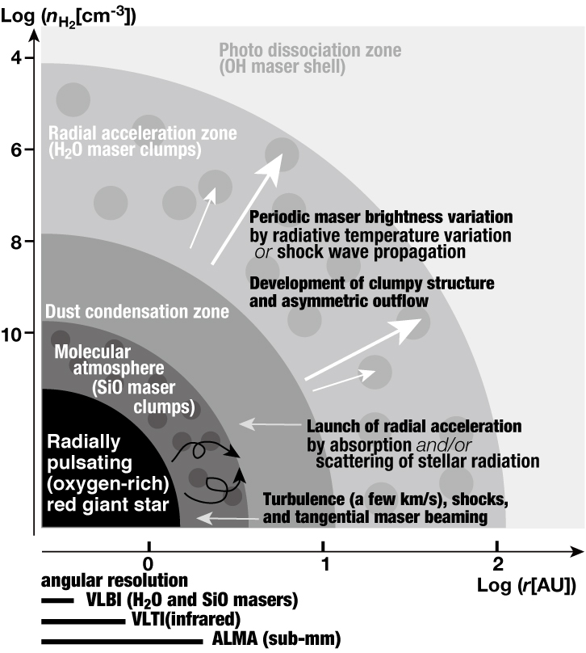
Circumstellar envelope and its JVN’s view
APT / SKA
KaVA (dynamic)
/ JVN (static)
KaVA (dynamic)
/ ALMA (static)
ALMA / VLT

Slide 12
Better with VLBA / EVN / HSA?
large / key projects driven
affected by communities’ present-day trends
JVN operated by universities
decadal / centurial academic activities
research time scale fixed by telescope lifetime
large key projects followed by key projects (for < 10 years) proposed by same research group

Slide 13
Towards era of the SKA
Collaboration with FAST will be pessimistic (?).
Starting with P-band (300 MHz)?
Start with collaboration with SHAO, ATNF, UTas
Domestic partners:
ISAS (Usuda 64 m), NICT (Kashima 34 m) for L-band
Collaboration at C-band (6.7 GHz) promising?
Science in L-band VLBI: OH lines
OH masers (MWG dynamics, stellar evolution)
→ see Nakagawa-san’s talk
OH thermal line (absorption with AGNs)
Developments towards the SKA
Wide-band system (1—25 GHz)
Low cost, low power consumption equipment
Reliable system operation scheme
Calibration scheme against ionosphere
Wide field imaging

Slide 14
Conclusions
Consider JVN’s “legacy projects”.
Decadal (loose) radio source monitoring
Mapping stellar masers toward “progenitors” (novas, SNe, WFs)
Challenge new ideas flexibly.
As pathfinder to SKA
Anticipating trials for ALMA

